Slide 1
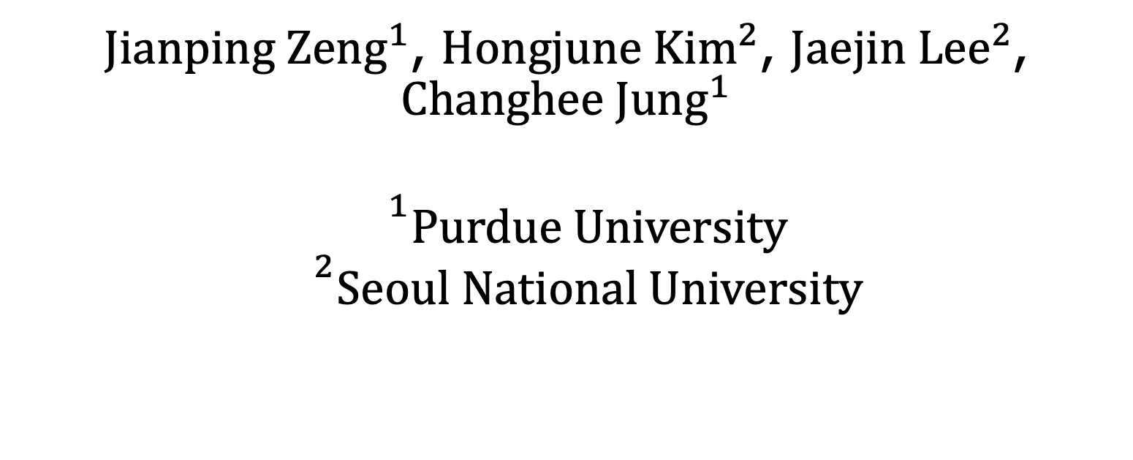
Turnpike: Lightweight Soft Error Resilience for In-Order Cores
$Jianping Zeng^{1}$, ${Hongjune Kim}^{2}$, ${Jaejin Lee}^{2}$,
$$Changhee Jung^{1}$$
$${}^{1}Purdue University$$
$${}^{2}Seoul National University$$
Notes:
Hello, this is Jianping from Purdue. Today, I am going to present the paper Turnpike: lightweight soft error resilience for in-order cores

Slide 2
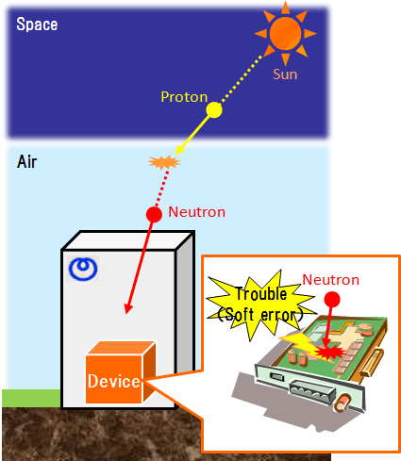
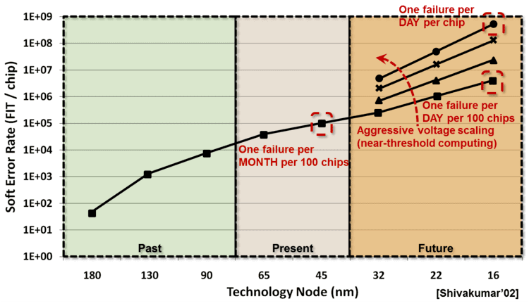
Soft Error and Its Increasing Concern
Notes:
Soft errors [pause] also known as transient faults lead to a bit flip and they are caused by high energy particle striking on the silicon. Unfortunately, the soft error rate goes up as technology node becomes smaller.

Slide 3
Single Bit Flip That Killed
Sudden acceleration of a 2005 Camry in a September 2007 accident that killed one woman and seriously injured another
https://www.eetimes.com/toyota-case-single-bit-flip-that-killed/
Notes:
Even thought soft error just flips the bit, it could result in deadly damage, e.g., people suspected the bit flip caused the crash of a Toyota vehicle and killed a passenger in 2007. The key point is soft error resilience is such a critical problem, thus people came up with a lot of soft error detection techniques.

Slide 4
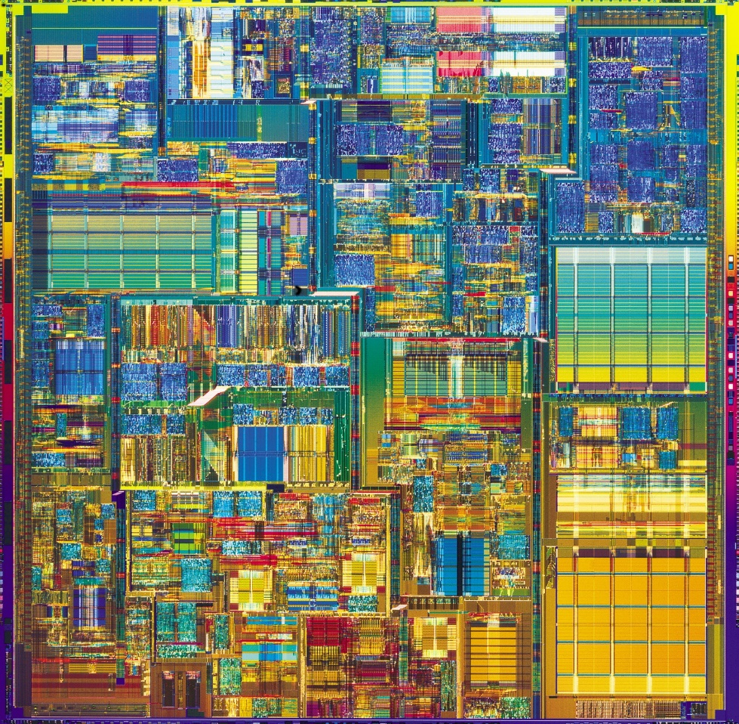
Acoustic Sensor Detection
Acoustic Sensor [ISCA’12, ISCA’14]
Low Cost (< 1% area overhead)
Bounded Worst-Case Detection Latency (WCDL)
Acoustic Sensor
WCDL
Notes:
Among them, [click] acoustic sensor-based error detection is particularly promising to detect soft errors in a low-cost manner, [click] incurring < 1% area cost of the chip. [click] It deploys a number of sensors on top of chip. When [click] a high energy particle hits the chip, [click] it always generates the sound wave as a result which can be perceived by deployed acoustic sensors.
In this way, there is no error missed. [click] Because of the propagation delay between striking location and sensor location, [click] it takes some cycles, [click] so called worst-case detection latency (WCDL), to sense the soft error.
Based on this sensor based error detection, it is possible to achieve soft error verification. [click]

Slide 5
Program Data Verification within WCDL
Execution till T1 is error-free?
Verified to be
error-free!
Time
T1
T2
WCDL
Notes:
Soft error verification is to make sure if some program execution is error-free.
The idea is very simple, let’s say if we want to know if the execution prior to t1 is error-free, we just need to wait for WCDL cycles till T2. If no error has been detected within WCDL cycles, then the execution before T1 is ensured to be error-free. Otherwise, an error must have been detected within the cycles, which indicates the execution prior to T1 has been corrupted.
Based on this soft error verification, we can achieve error containment by only releasing verified data, let’s see how the state-of-the-art work can do core-level containment [click]

Slide 6
Turnstile (MICRO’16): Core-Level Error Containment
GSB
SQ
SB
[* GSB: Gated Store Buffer]
Notes:
To contain error in the core so as not to corrupt data in ECC-protected memory, [click] Turnstile repurposes the store buffer in the core as gated store buffer, GSB such that Turnstile can control the release of the entries in the GSB without releasing any unverified data to the cache. [click] In this way, no error escapes from core to the cache.
Let’s see how turnstile works. [click]

Slide 7
Turnstile (MICRO’16): Verify Memory States
WCDL
Rg1
Rg2
[* GSB: Gated Store Buffer]
Verified
C
A
B
A
B
Store verification allows memory verification
How to verify the register state?
Time
t₁
t₂
t₃
t₄
t₂
t₁
WCDL
Store [A]
Store [B]
…
Rg1
Store [A]
Store [B]
…
Store [C]
…
C
B
A
B
A
GSB
…
Store [C]
Rg2
Notes:
since GSB is limited, turnstile achieves core level error containment in region-level by [click] partitioning the program [click] into a series of regions with GSB size in mind. So that number of stores in each region is less than the GSB size.
[click, click] When the program is executed in a [click] region-by-region manner, [click] GSB buffers those unverified stores in each region.
[click] assume there is an error happens in region 2, which will be detected later.
[click] At time t3, region 1 is verified to be error-free after spending WCDL cycles since the end of region 1. Therefore, [click] those stores of region 1 here, store A and B , can be safely released to the memory.
[click] At time t4, [click] acoustic sensor detects an error, however, region 2 has not been verified yet because WCDL cycles haven't been passed yet since the end of region 2. Turnstile then [click] squashes every stores in the GSB after last verified region boundary. Then, [click] the program rolls back to the last verified region boundary.
[click] in this way which we call store verification, turnstile can verify the memory state as part of program status.
[click] The remaining question is how Turnstile verifies the register state which is also part of program status? [click]

Slide 8

Turnstile (MICRO’16) : Verifying Register
States
r1 = …
Verified
Checkpoint is essentially a store.
Turn register verification into memory verification
ckpt r1
Live-out
Rg0
r2 = …
r3 (dead) = …
Verified
ckpt r2
Rg1
Live-out
… = r1
… = r2
r3 = …
r1 = ld ckpt_r1
r2 = ld ckpt_r2
Corrupted
Rg2
Notes:
To verify register status, [click] turnstile identifies the live-out registers in each region, here, r1 in the region 0 and r2 in the region 1 as both of them will be used in region 2.
[click] Then Turnstile compiler checkpoints those live out registers with [click] a checkpoint store after their definitions. In this way, [click] Turnstile turns the register verification into memory verification.
We assume [click] region 0 and [click] region 1 are both verified, [click] and a soft error is detected in region 2. Turnstile only needs to rollback to the last verified region boundary.
Remember that the memory state remains the same as all the stores after the last verified region are squashed. The checkpointed register state in the memory also remain intact because we turn register verification into memory verification.
[click] Before rolling back to the last verified region boundary, [click] turnstile needs to first recover the register state by simply reloading checkpoint register values, here., r1 and r2, from checkpoint storage in memory. [click] Then we can go back to the last verified region boundary for recovery.
However, turnstile doesn’t work for in order cores. [click]

Slide 9



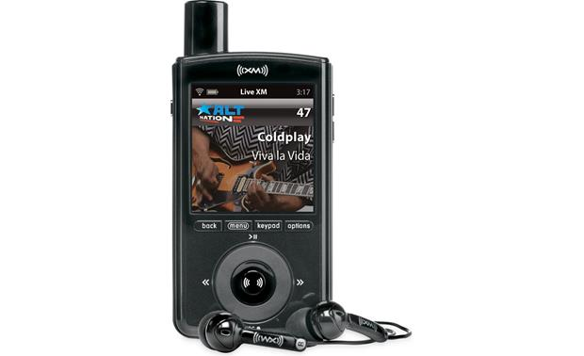

Protect In-Order Cores by Turnstile (MICRO’16)?
Turnstile Is Not Applicable
Notes:
[click] Given that in-order core is usually deployed in the embedded systems for critical tasks, e.g., spying drone, bionic bird, wearables, and portable military devices, where power-efficiency and weight are the two of most important design factors. The prior work Turnstile is a potentially appealing solution to protecting in-orders against soft errors.
[click] However, the prior work turnstile is not applicable to the in-order cores, let’s see the reasons [click].

Slide 10
Limitations of Turnstile (MICRO’16)
Small SB size on in-order cores leading to superfluous checkpoints, e.g., 4 on In-Order VS 40 on OoO cores.
High SB pressure due to store verification (WCDL latency) in the SB.
Delayed checkpoint execution due to data-dependence.
Turnstile doesn’t work because of high SB pressure
Notes:
[click] Turnstile’s SB-directed region partitioning makes the small SB size on in-order core become a big issue, e.g., only 4 SB entries in ARM cortex A53 in-order core compared to 40 SB entries in out-of-order cores. It leads to too many inserted checkpoints and thus puts high traffic to the tiny SB. [click] In addition, verifying stores in the SB keeps such high SB pressure for a long time, which execrates the SB pressure. Moreover, [click] Turnstile’s register checkpointing introduces a data-dependence between checkpoint and the definition of checkpoint register, which delays the execution of checkpoint and makes checkpoint stay longer in the SB, further leading to high SB pressure.
[click] In summary, turnstile doesn't work for in-order cores, and the reason is all about the high store buffer pressure.
Let’s see how we reduce SB pressure [click]

Slide 11
Turnpike: Reduce SB Pressure
r1 = …
ckpt r1
r2 = …
ckpt r2
r1 = …
ckpt r1
r2 = …
r1 = …
r2 = …
ckpt r1
#1
Fast Release
#2
#3
Store Buffer
Store Buffer
Store Buffer
Store Buffer
Compiler Optimizations
#1: Store elimination
Hardware Support
#2: Instruction scheduling
#3: Store Fast Release
* WAR: write after read
Notes:
To reduce SB pressure, our own work turnpike introduces a series of [click] compiler techniques to [click] eliminate stores as [click] as shown in the figure. For the remaining checkpoint stores, [click] the proposed instruction scheduling can [click] hide the execution latency of checkpoints. After that, [click] proposed hardware techniques can fast release remaining stores without verification.
Let’s see how store elimination reduces the SB pressure [click]

Slide 12
Store Elimination: Reducing Traffic to SB
#1: Superfluous checkpoint stores
Program
Regular
Stores
Checkpoint
Stores
Spill
Stores
Eliminate redundant checkpoints
[* Pruning of PLDI’20 and new LIVM]
Move checkpoints out of loops
[* newly proposed LICM]
Pipeline
#2: Spilling stores
Store Buffer
Register Allocation Trick
[* 1.7% spilling store removed]
Caches
* LIVM: loop induction variable merging
* LICM: loop invariant checkpoint motion
Notes:
In general, we have three kind of stores, first is regular store coming original program, checkpoint stores for checkpointing registers, and spilling stores generated by compiler itself.
To eliminate checkpoint stores and spilling stores, [click] we use checkpoint pruning from our prior PLDI work and proposed new loop induction variable merging to eliminate redundant checkpoints. In addition, we use our new loop invariant checkpoint motion to move checkpoints out of the loops. Furthermore, [click] we hack the register allocation to minimize spilling stores, hereby, we have average 1.7% spilling stores reduction.
For more details about our compiler techniques, please refer to our paper.
after store elimination, remaining checkpoints still pose pressure on SB due to the data dependence of a checkpoint store, which makes it stay longer in the SB.
Let’s see how we solve this issue [click].

Slide 13
Checkpoint Puts Pressure on SB
Checkpoints stay longer in the SB due to data-dependence introduced by checkpoint stores
Time
inst1:r6 = ld …
IF | ID | EX | MEM | WB
 | IF | ID | EX |  | EX | MEM | WB
 |  | IF | ID |  | ID | EX | MEM | WB
 |  |  | IF |  | IF | ID | EX | MEM | WB
true-dep
inst2: ckpt r6
inst3: r5 = r5 * r1
……
inst4: r4 = r4 << 2
Execution delay
Notes:
in the original turnstile's register checkpointing, the execution of checkpoint will be delayed due to [click] introduced data-dependence between checkpoint and the producer of checkpoint register, causing a data hazard which is a [click] big issue for in-order cores.
Let’s see how we solve this issue[click]

Slide 14
Instruction Scheduling to Reduce SB
Pressure
Key Idea: Tell compiler that checkpoint is not aliased with other memory operations and can be moved within the region
Time
IF | ID | EX | MEM | WB
 | IF | ID | EX | MEM | WB
 |  | IF | ID | EX | MEM | WB
 |  |  | IF | ID | EX | MEM | WB
inst1:r6 = ld …
inst2: ckpt r6
inst3: r5 = r5 * r1
inst4: r4 = r4 << 2
……
true-dep
Notes:
As we talked before, checkpoint is essentially a store of which the data is never used during regular program execution, thus checkpoint is never aliased with other memory instructions and can be scheduled within the region.
With those information, we can move [click] the checkpoint all the way down to the bottom position to hide the execution latency of checkpoint stores.
After scheduling checkpoint, remaining stores still need to be verified in the SB for WCDL cycles, putting pressure on the SB, let’s see how we fast release those remaining store without verification [click]

Slide 15
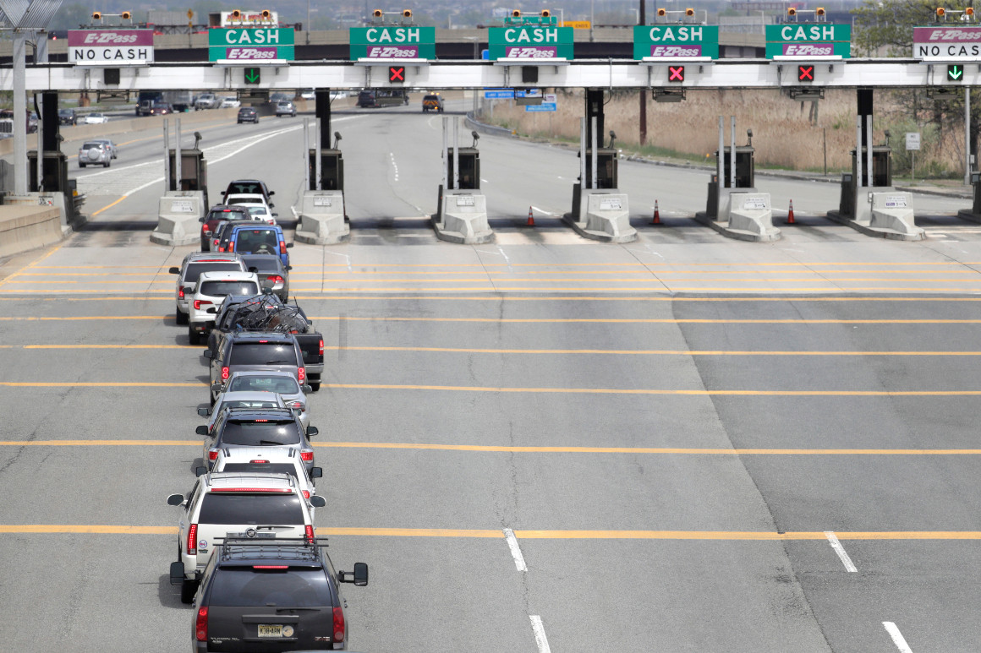
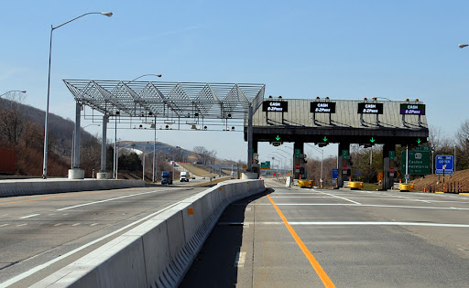
Fast Release Store for In-Order Cores
Turnpike
Turnstile [MICRO’16] @ In-Order Cores
Selectively Fast Release regular stores and checkpoints
Notes:
Turnstile blindly holds all stores in the store buffer for verification, which gives high pressure on SB especially for the tiny SB on in-order cores. [click] We observe that not every store should be verified in store buffer for WCDL cycles. [click] Here, we have an analogy, turnpike has two kind of techniques to fast release regular stores and checkpoint stores from store buffer directly to the L1 cache without verification, therefore, we can significantly reduce pressure on store buffer.
Let’s see why it is safe to fast release regular stores and how we do that [click]

Slide 16


Bypass Store Verification for Fast Release
Key Insight: Fast releasing Write-After-Read (WAR)-free store has no harm for recovery
Pipeline
…
r3 = Load [100]
…
Store r0, [80]
…
Rg1
Reload checkpoints
SB
WAR-free
Bypass
Verification
Rg2
Caches
Recovery Process
Notes:
For those remaining regular stores in the SB, we found out that it is not necessary to verify write-after-read (WAR)-free stores in SB. This is because those store data are never used on region re-execution in case of an error detected, meaning that its corruption doesn’t affect the correctness of region reexecution.
in the left side, we clearly see load and store access different memory location, thus [click] store is WAR-free and we can fast release that store directly to the cache without verification. [click] When an error is detected in the bottom of second region, [click] recovery process goes back to the beginning of faulty region after reloading checkpointed registers. During re-execution, load still gets the same value due to lack of WAR-dependence on load address 100. As a result, re-execution of second region generates the same output, [click] thus correctly recovering the program status.
Let’s see how we detect WAR-free stores[click]

Slide 17

WAR-Free Regular Store Detection
Committed Load Queue (CLQ): keep committed load addresses & used for comparing store address
head
CLQ
tail
c1:ckpt r0
...
r0 = ld, [100]
c2:ckpt r0
st …,[ ]
=
=
=
=
Rg1
[100,104)
Bypass?
Rg2
50
[50,54)
* CLQ: committed load queue
Notes:
To detect WAR-free store, we propose a hardware structure, so called committed load queue (CLQ) saving the address range of the committed loads for subsequent query. [click] When the processor commits a load instruction, [click] it saves the address range here [100, 104] into CLQ.
[click] When a store is committed, processor [click] compares the store [click] address range [50, 54] against [click] each CLQ entry to find out [click] whether there is a matching address. If It turns out that [click] there is no matching address found in CLQ, which mean that store is WAR-free. Then we can fast release that store and let it go to L1 cache directly.
This is the way we can fast release regular stores, let's see how we fast release checkpoint stores [click]

Slide 18


The Issue of Fast Release Checkpoint Stores
Checkpoints are WAR-free but bypass must be careful!
1. r2 = r2 + 4;
……
2. r2 = ld [r2];
……
r2 Storage
c1. ckpt r2;
0
0
10
Rg1
Overwrite
Root Cause: checkpoint same register to same storage
WCDL
c2. ckpt r2;
10
Rg2
Notes:
Technically, checkpoint store is only used at recovery time and thus it is WAR-free by definition, which means checkpoint stores don’t even need to search CLQ. The takeway is that we can fast release checkpoint stores.
However, care must be taken for the checkpoint storage overwriting problem. The thing is that turnstile checkpoints the same register to the same memory storage in order to simplify recovery process. As a result, WAR-free fast release for checkpoints will corrupt checkpoint storage, resulting incorrect recovery.
Let's see an example. When processor is [click] executing the first checkpoint c1, it [click] writes value 0 to the r2's checkpoint storage. After that, [click] processor is executing second checkpoint c2 while the first region is being verified. It [click] writes 10 to the same checkpoint memory location if we fast release second checkpoint c2. However, we can see [click] second checkpoint overwrites the data of first checkpoint. If second checkpoint gets corrupted on [click] error detected on the end of second region, [click] while we re-execute the second region from its beginning, the processor will read a wrong value [click] 10 instead of 0 as the address for reexecuting that load instruction, therefore, [click] leading to wrong recovery.
Let’s look at how to leverage hardware technique to solve this issue. [click]

Slide 19

Hardware Coloring for Checkpoints
Solution: Allocate 2 colors (storages) for each register for alternatively checkpointing
Blue
Red
Storage Color
Pool
Rg 0
…
c1:ckpt r0
...
r0 = ld, …
c2:ckpt r0
…
r0
Rg 1
0
0
Rg 0
WCDL
Used Colors
Rg 1
10
10
0
r0
Verified Colors
0
Notes:
To deal with this overwriting problem, we propose to checkpoint the same register of different regions to different memory storages.
To do that, we pre-allocate a [click] color pool which contains multiple colors, e.g., blue and red, for each register. When a checkpoint is committed, we look for an available color in the color pool with the checkpointed register as a key, here., [click] we assign c1 to the blue storage and save [click] this kind of color assignment in used color map, then, [click] we write c1 to the blue storage. When number of colors is not enough, we fall back to the original Turnstile verification.
Processor [click] then continues execution of following instructions till the region 0 gets verified. At this point, region 0 is [click] verified to be error-free because we already passed WCDL cycles since the end of region 0 and no error was detected during WCDL cycles, [click] we then copy those kind of assignment information to the verified color map in case of error recovery. Similarly, when processor [click] gets to the second checkpoint c2, we [click] assign red to c2 and thus [click] write c2 to the red storage because red is available in the color pool.
In the bottom of region 1, [click] we detect an soft error which happens to [click] corrupt the c2 while region 1 is being verified. But this corruption doesn’t matter since we can read correct checkpoint values according to the color assignment information saved in verified colors map. With that in mind, processor [click] goes back to the beginning of the faulty region 1 with checkpoint value from blue storage and [click] correctly recover the program status.
With all of those techniques, Turnpike can effectively reduce the store buffer pressure. Let's see the resulting performance number [click]

Slide 20
Methodology
Gem5 simulator
Compilation Toolchain
Dragonegg/LLVM/ARM GCC
Comparing schemes
Original program without soft error resilience support (baseline)
Turnstile [MICRO’16]
Turnpike
Processor | 2-core, In-Order, 2.5GHz, ARMv7
L1 I/D cache | Private, 32/64KB, 2-way, 2-cycles
L2 cache | Shared, 128KB, 16-way, 20-cycles
SB size | 4
CLQ size | 2
Benchmarks
CPU2006 & CPU2017 | SPLASH3
Notes:
We evaluate our performance of CPU2006, CPU2017, and SPLASH3 on the gem5 simulator. All programs are compiled by LLVM compiler with our techniques enabled. To fairly compare the performance, we implement the state-of-the-art, turnstile, on the same platform.

Slide 21
The Impact Of Turnpike’s Optimization
Turnstile
+ Store Elimination
+ Inst Sched
+ Fast Release (Turnpike)
68% SB Pressure Reduction!
Table: Ratios of eliminated/bypassed stores to total stores
29%
Pruning | LIVM | LICM | RegAlloc-Trick | Store Bypass
21% | 5% | 1.4% | 1.7% | 39%
Overhead
10%
7%
0%
Notes:
This figure shows turnpike techniques can synergistically reduce the performance overhead from original 29% gradually to near zero. Here, compiler enabled store elimination and instruction scheduling can reduce the overhead significantly from 29% to 7%, while hardware-based store fast release can reduce the overhead further to zero. [click] this Table shows store elimination can reduce 29% stores, and store bypass can fast release 39% stores, which indicates turnpike [click] can significantly reduce 68% store buffer pressure.

Slide 22
Normalized Overhead Over Baseline
Turnstile
Turnpike
43%
33%
29%
Overhead
18%
9%
0%
0.07%
0%
CPU2006
CPU2017
SPLASH3
All geomean
Notes:
This figure shows turnpike incurs almost 0 overhead especially for CPU2006 and CPU2017. What’s interesting here is turnpike still incurs 9% overhead for SPLASH3 programs even with our techniques. This is because both Turnstile and Turnpike treat a fence instruction as a region boundary, which forces the verification of the stores preceding the fence. thus incurring the synchronization overhead for multi-threading program.

Slide 23
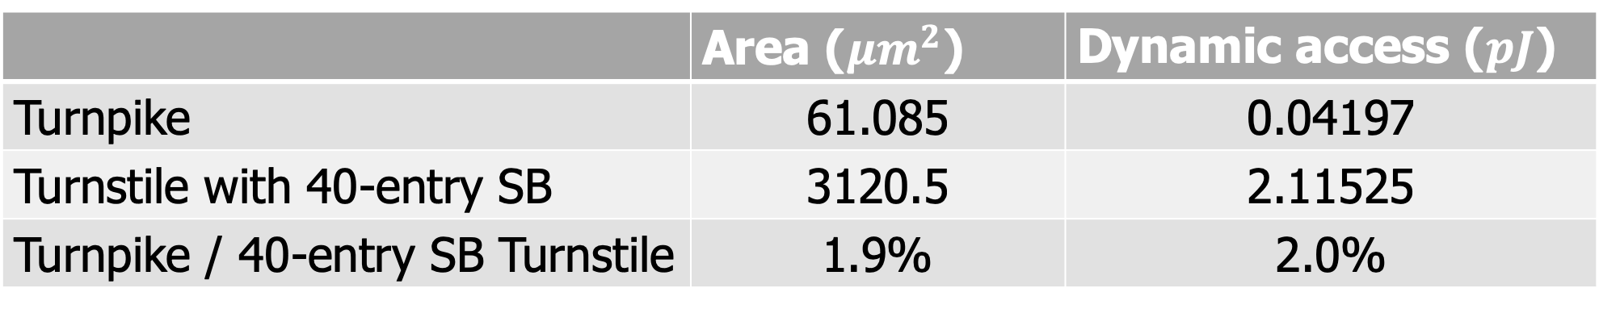
Hardware Cost Analysis
 | Area (${μm}^{2}$) | Dynamic access ($pJ$)
Turnpike | 61.085 | 0.04197
Turnstile with 40-entry SB | 3120.5 | 2.11525
Turnpike / 40-entry SB Turnstile | 1.9% | 2.0%
Notes:
This table shows our design turnpike incurs only 1.9% area cost and 2% power consumption overhead compared to simply increasing the SB size of the in-order cores to 40.

Slide 24
Conclusion
Turnpike is the first low HW/run-time cost solution to making acoustic-sensor-based soft error resilience work for in-order cores.
Turnpike’s compiler optimizations generate less stores.
Turnpike’s novel hardware schemes can bypass store verification, which lowers SB pressure without compromising resilience guarantee.
Notes:
In conclusion, turnpike is the first low hardware and run-time cost solution to making acoustic-sensor-based soft error resilience work for in-order cores. It shows compiler techniques not only reduce checkpoint stores but also generate less spilling stores. Moreover, turnpike novel hardware techniques can bypass the store verification in the SB which lowers SB pressure without compromising resilience guarantee.

Slide 25
Questions?
Notes:
Please refer to our paper for more details. Thank you.

Slide 26
Jianping Zeng @Purdue University
(zeng207@purdue.edu)
This presentation and recording belong to the authors. No distribution is allowed without the authors' permission.

